Slide 1
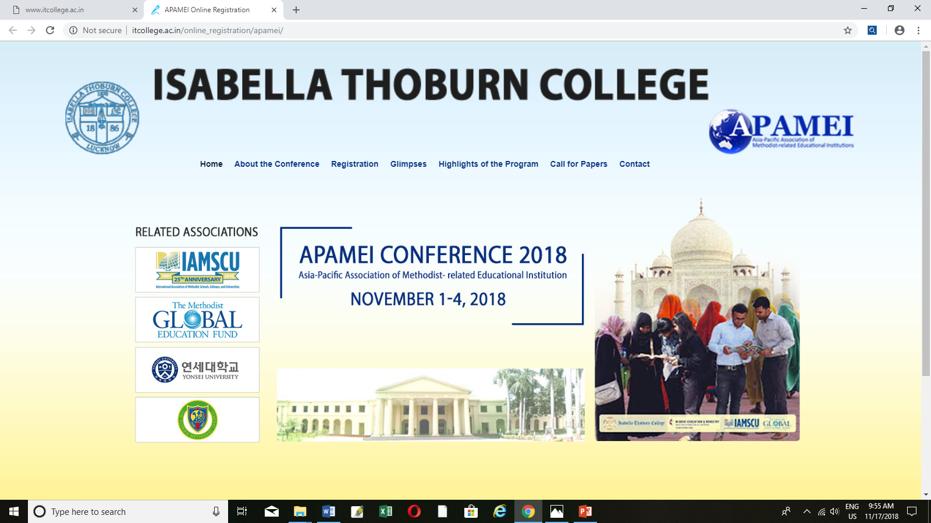

Slide 2
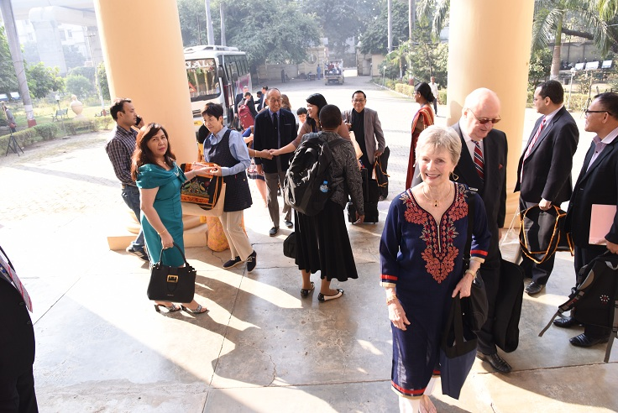
Asia Pacific Association of Methodist Related Educational Institutions (APAMEI)

Slide 3
Conference Theme
The Main theme of the Conference is “Transcending Boundaries for Peace: Making Peace Peacefully”

Slide 4
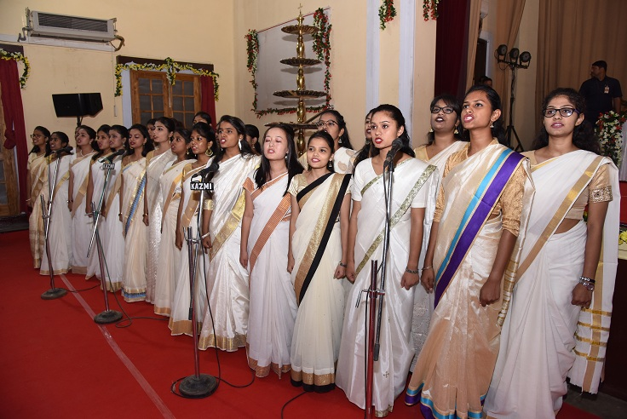
DAY 1 Morning Devotion A morning prayer is a wonderful way to focus your time and attention.

Slide 5
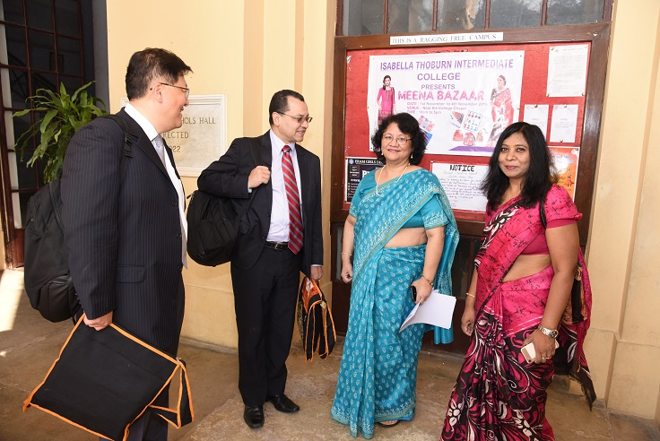

Slide 6
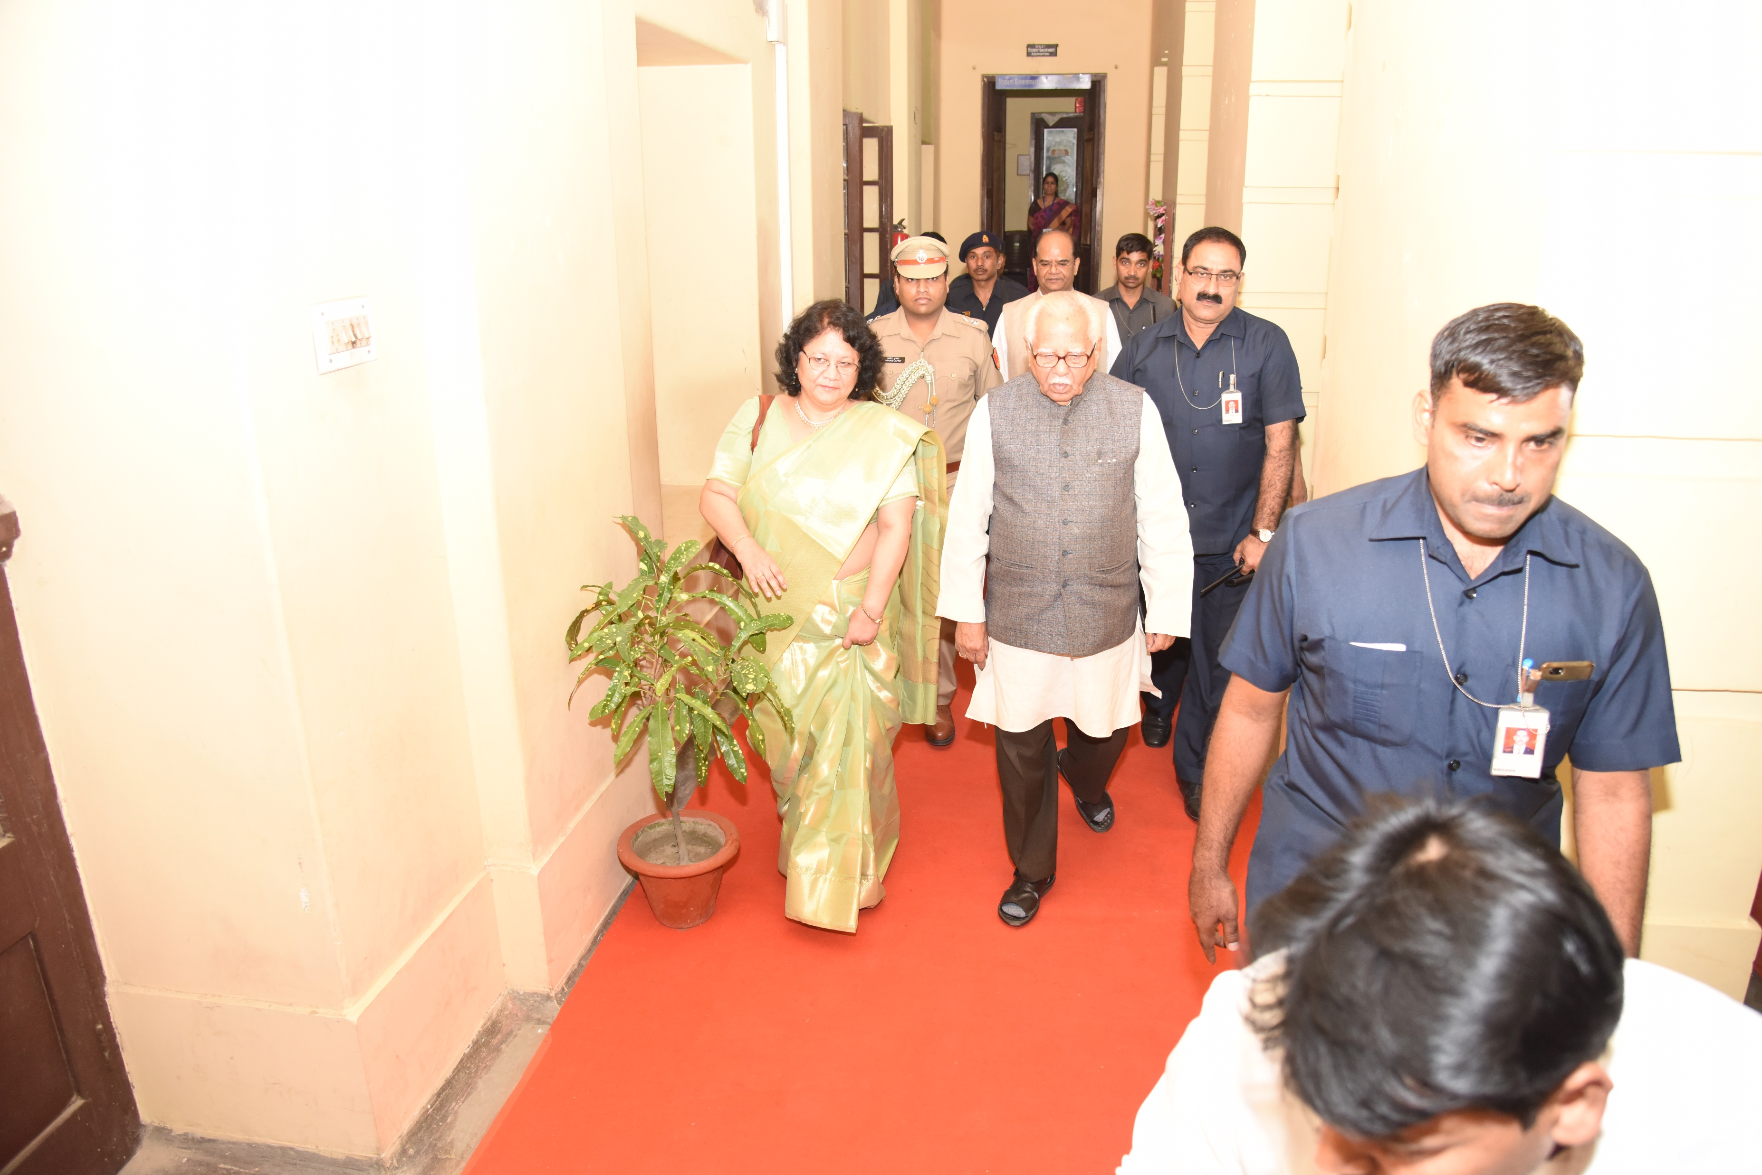
Inaugural Session Opening ceremony by the chief guest Sri Ram Naik (Hon’ble Governor, Uttar Pradesh)

Slide 7
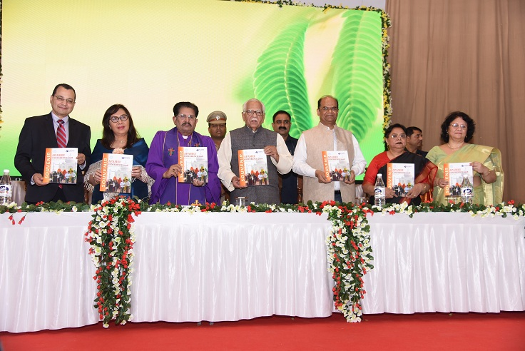

Slide 8
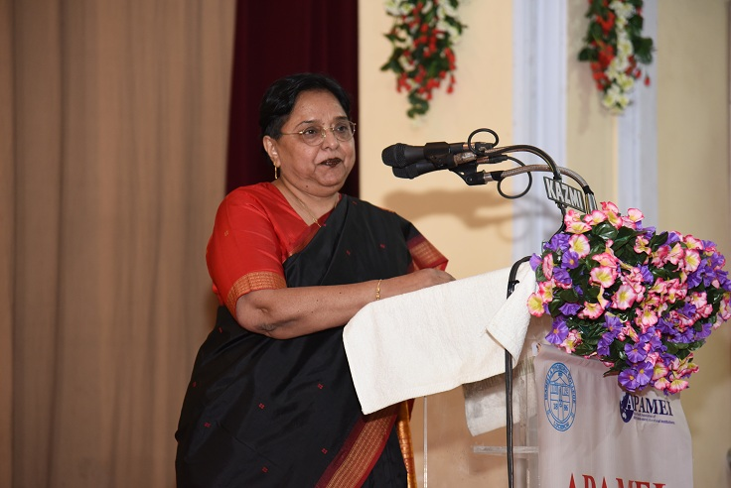

Slide 9
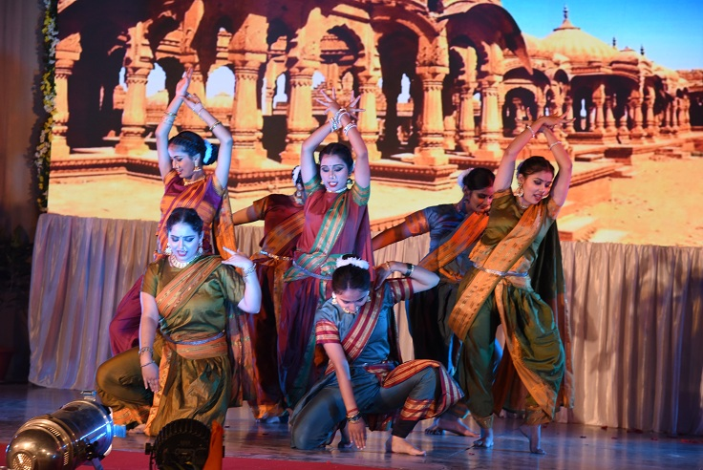

Slide 10
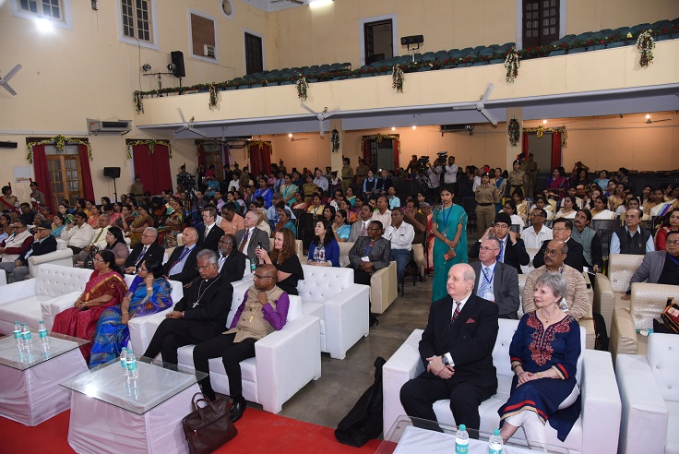

Slide 11
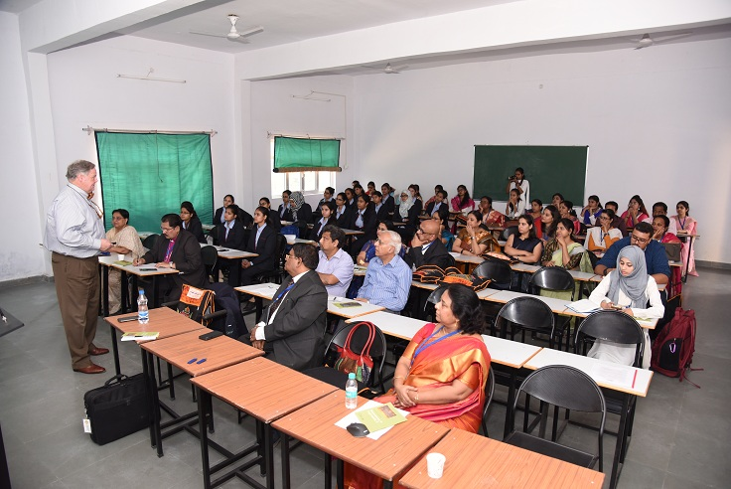
PARALLEL SESSIONS Interactive sessions on topics like : “Economy and Education”, “Education and Culture: Contribution of Methodism” “Responsible Citizenship on Ecological Crises” “Gender: The Unfinished agenda” etc. by eminent speakers.

Slide 12
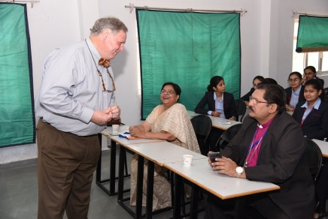

Slide 13
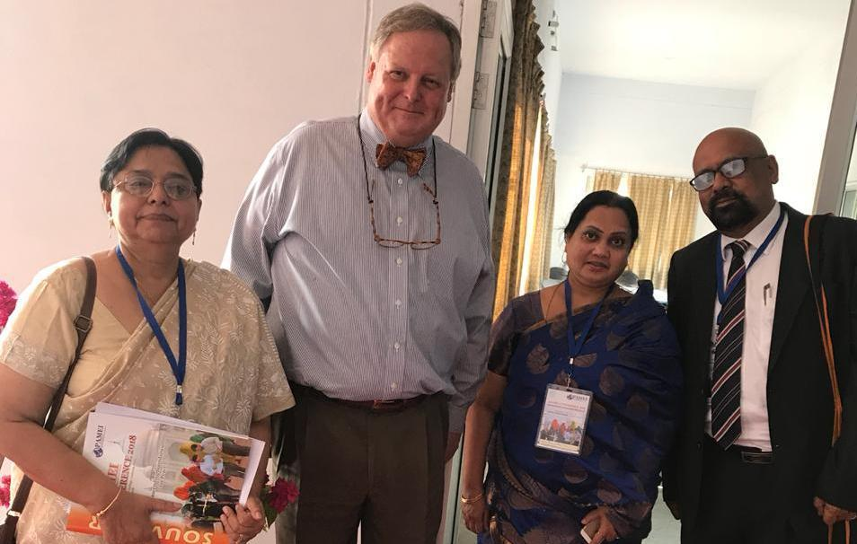

Slide 14
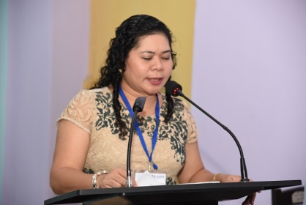

Slide 15
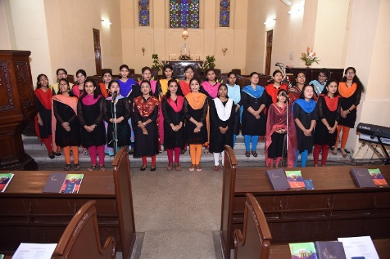
DAY 2 Morning Devotion You will keep in perfect peace him whose mind is steadfast, because he trusts in You.

Slide 16
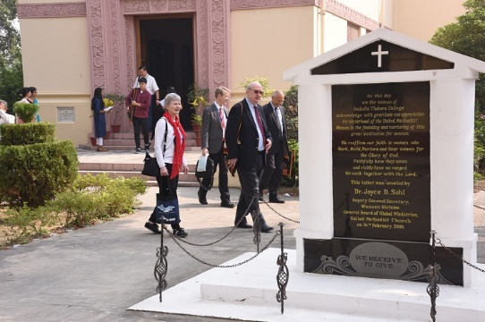

Slide 17
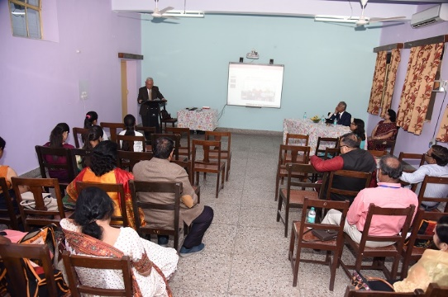
PARALLEL SESSIONS Interactive sessions on topics like : “Pluralism and Secularism”, “Economy and Technology” “Methodists as Peace Maker” “Race, Gender and Environment” etc. by various eminent speakers.

Slide 18
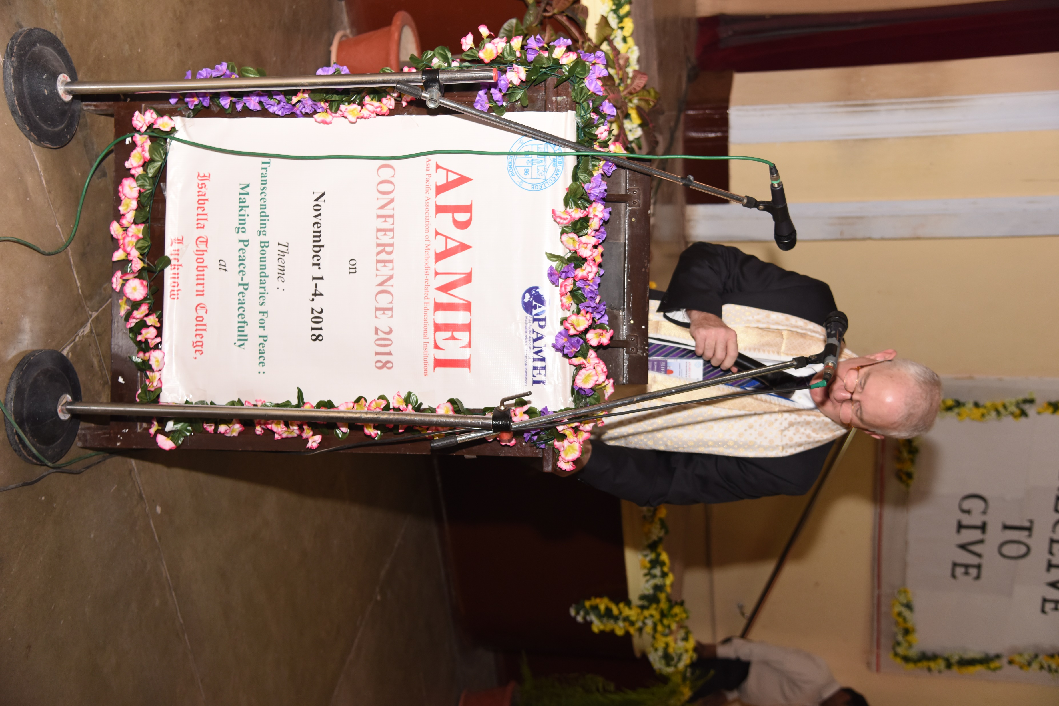

Slide 19
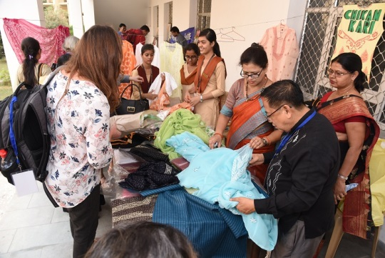
Meena Bazar Shopping at Campus

Slide 20
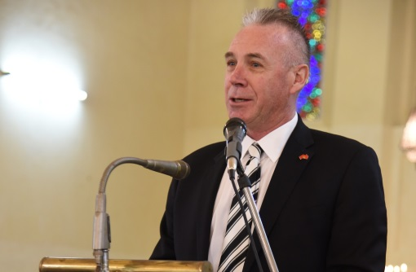
Day 3 Morning Devotion Prayer is the greatest way to start your day

Slide 21
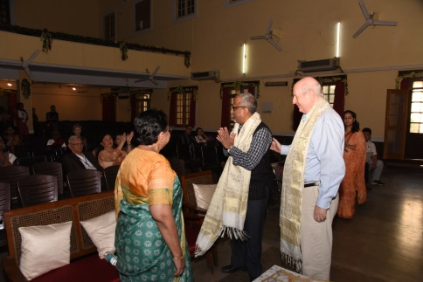

Slide 22
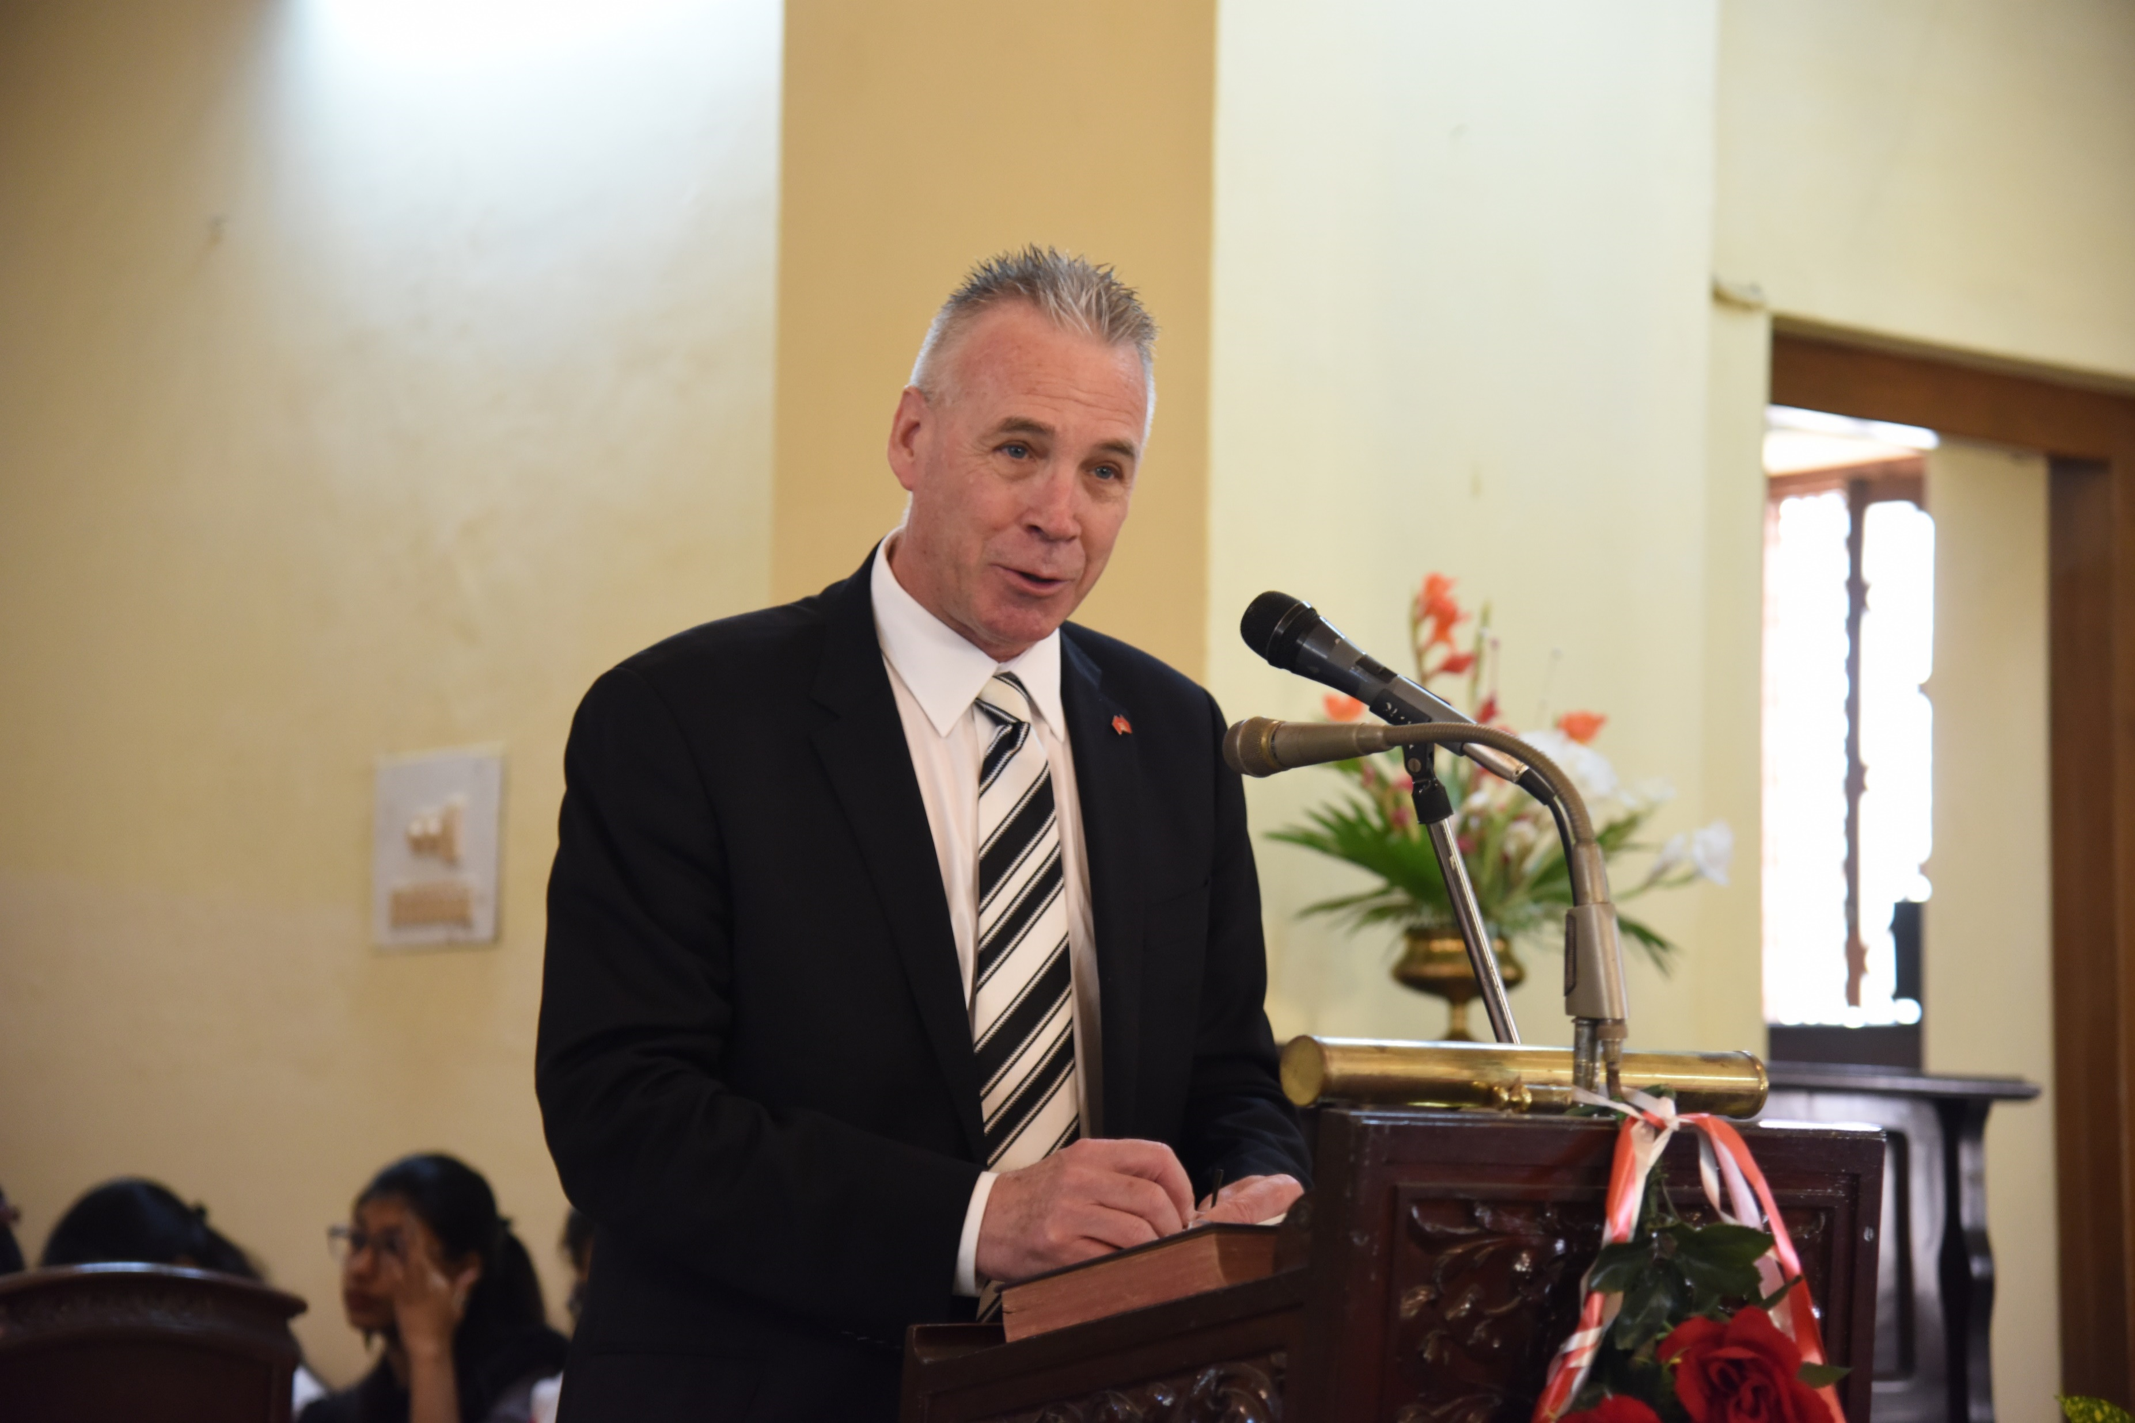

Slide 23
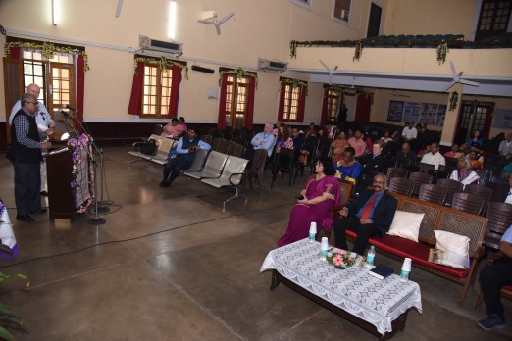

Slide 24
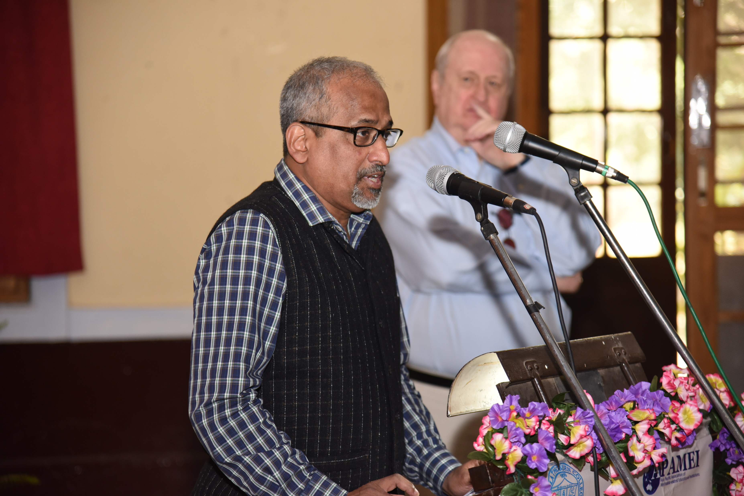

Slide 25
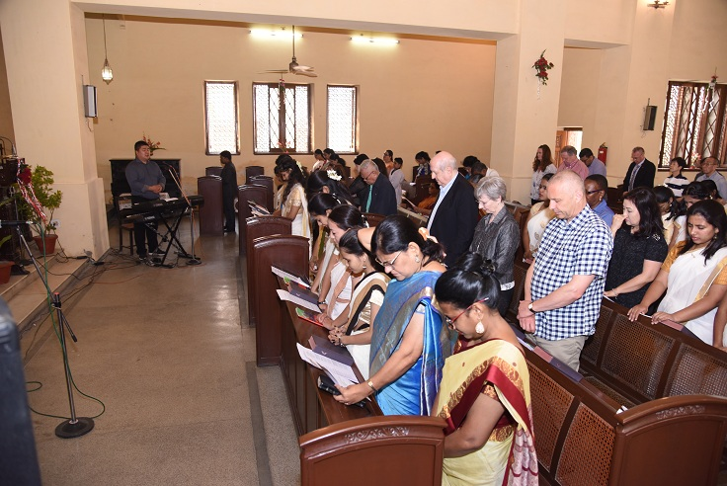
DAY 4 Morning Devotion Daily Devotion is about helping you take your next step of faith.

Slide 26
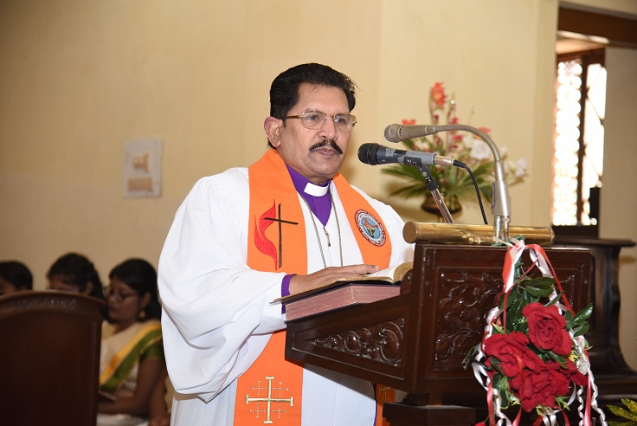

Slide 27
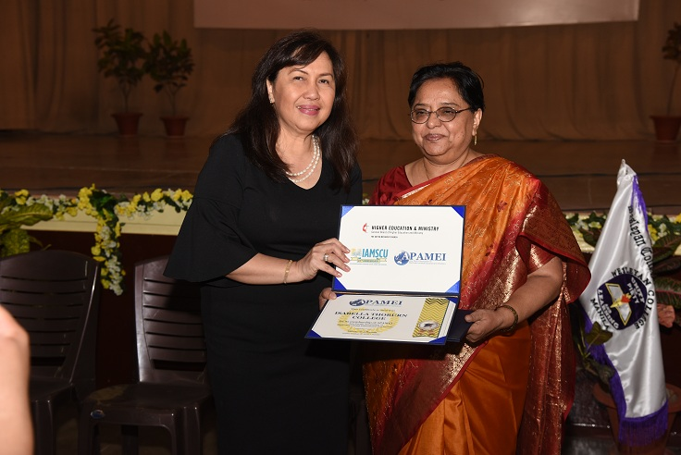

Slide 28
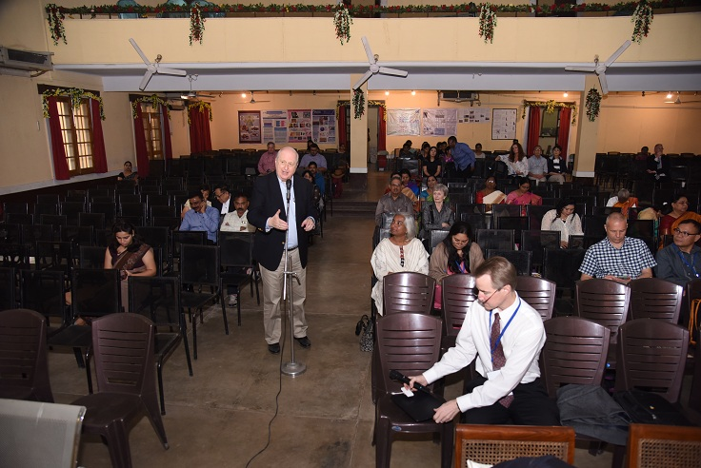

Slide 29
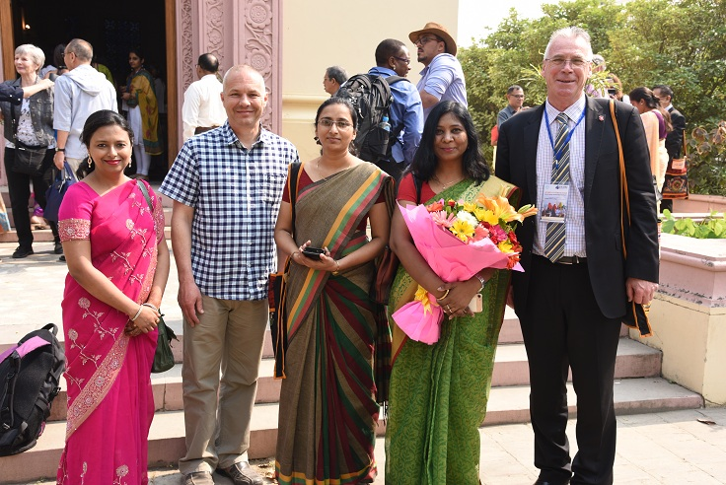

Slide 30
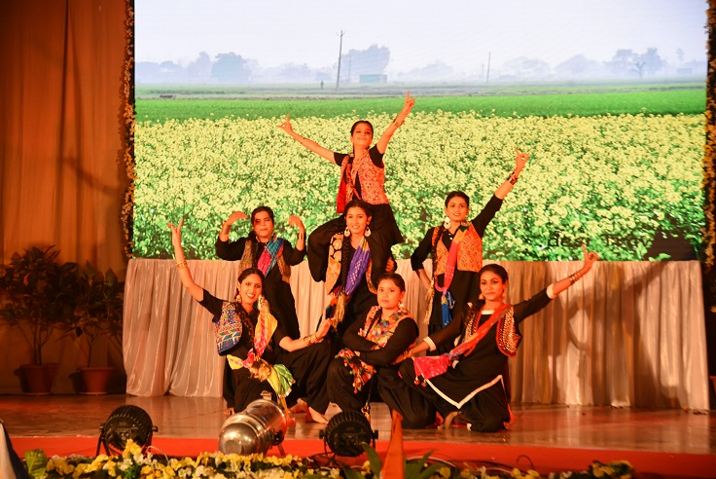
The Journey Ends…………………..

